Slide 1

Committee Parameters and Guidelines

Slide 2
Composition of Selection Committees
5 voting members
2+ (Co-ed)
3+ (Women's)
1 non-voting champ. committee
Committee members selected by championship committee

Slide 3
Limitations on committee members
Coaches:
Permitted but cannot discuss/vote their own team
Any Affiliation: Donors, alums, parents, etc. must disclose any affiliation
Undergraduates:
Ineligible for committee

Slide 4

Competitive
Strength
Ranking

Slide 5
CSR assists teams and committee in important decision making
      Teams
      Selection Committee
Proper event identification
No penalty for poor opponents
Empirical data of performance
Helpful in indirect comparisons

Slide 6
Events are graded to reflect relative difficulty
Conference Submission
Grading Release
Event Scheduling
Points
Earned
Year-end Ranking
Conference submit schedule
Recommend grading for events

Slide 7
Events are graded to reflect relative difficulty
Conference Submission
Grading Release
Event Scheduling
Points
Earned
Year-end Ranking
Conference submit schedule
Recommend grading for events
Championship committee reviews
Releases grading for all events

Slide 8
Events are graded to reflect relative difficulty
Conference Submission
Grading Release
Event Scheduling
Points
Earned
Year-end Ranking
Conference submit schedule
Recommend grading for events
Championship committee reviews
Releases grading for all events
Team schedule events
Full knowledge of ranking value

Slide 9
Events are graded to reflect relative difficulty
Conference Submission
Grading Release
Event Scheduling
Points
Earned
Year-end Ranking
Conference submit schedule
Recommend grading for events
Championship committee reviews
Releases grading for all events
Team schedule events
Full knowledge of ranking value
Points awarded for each event
Based on finishing place and event grade

Slide 10
Events are graded to reflect relative difficulty
Conference Submission
Grading Release
Event Scheduling
Points
Earned
Year-end Ranking
Conference submit schedule
Recommend grading for events
Championship committee reviews
Releases grading for all events
Team schedule events
Full knowledge of ranking value
Points awarded for each event
Based on finishing place and event grade
Top 6 events for each team added
All teams ranked high-low

Slide 11
Total event score is based on finishing place and competitive level
      Finishing Place in Event
      Event Grading Factor
      Total Event Score

Slide 12
Points scaled by finishing place
1. Derived from "Method of Calculating the World Sailing Match Race Rankings"

Slide 13
Events are graded by level of competition
Event Grade | Point Multiplier
G0 | 8.0x
G1 | 6.5x
G2 | 4.0x
G3 | 2.5x
G4 | 1.5x
G5 | 1.0x
G0
G3
G5
Showcase Finals
MCSA Championship
Fundamental Events
Note: Examples, non definitive

Slide 14
Example Performance by Team
Finishing Place | Finishing Score | Event Multiplier | Total Event Score
5 | 60 | 6.5 | 390
6 | 50 | 6.5 | 330
3 | 80 | 4.0 | 320
1 | 100 | 2.5 | 250
7 | 40 | 4.0 | 160
9 | 20 | 6.5 | 130
3 | 80 | 1.5 | 120
10 | 10 | 8.0 | 80
14 | 6 | 4.0 | 24
20 | 0 | 6.5 | 0
Top 6 scores
=
1580

Slide 15
Strength Based
Transparent
Selection Process
Fair
Simple

Slide 16
Championship field is filled through multiple selection rounds
Increasing Championship Field Size
R1
Round 1
  Top 2 teams from conference championships
R2
Round 2
  Direct selection to championship field
  Requires 80% of votes from committee members
Teams are separated into groups based on their competitive strength ranking (CSR)
R3
Round 3
  Structured by CSR
  Fills 2/3 of remaining berths
R4
Round 4
  Reduced number of berths are selected
RX
Round X
  Final berth is filled

Slide 17
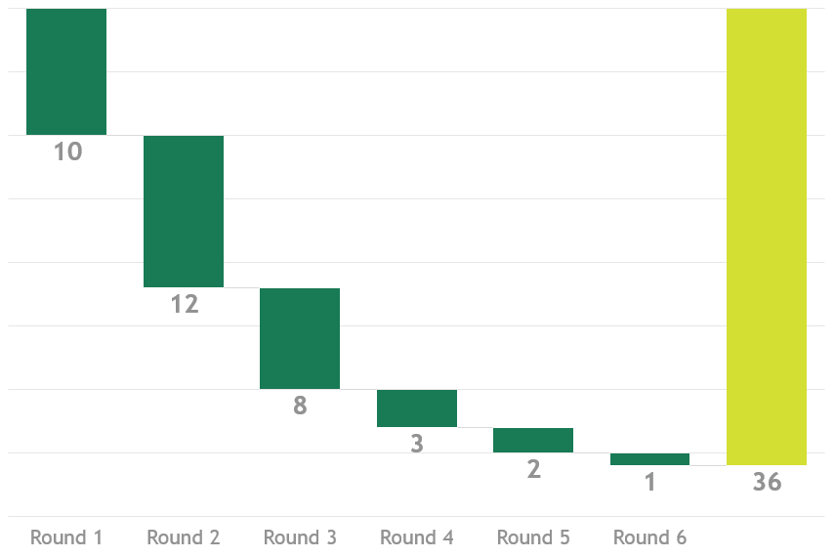
Selection, by rounds, to fill championship field
1
Conference Champions
2
Direct Selection
3+
Selection structured by competitive strength ranking

Slide 18
Round 3+, groups of teams are segregated by their ranking score and assessed on their cumulative performance
Group is formed based on highest CSR
# teams in group
=
2x available berths remaining
All teams not yet allocated to championship field
Individual members order the group of teams by performance in that discipline
Remained returned to CSR list
Sorted by average, top 1/3 to championship field

Slide 19

Example Selection Rounds 1-3

Slide 20
Example scenario
      Round 1:
      Conference Champions (top 2)
      Round 2:
      Direct selection teams
      Round 3+:
      All remaining teams
#1
#3
#7
#4
#12
#13
#22
#27
#34
#40
#2
#5
#6
#8
#9
#10
#11
#14
#15
#16
#19
#21
#17
#18
#20
#23-26
#28-33
#35-39
#41+

Slide 21
Selection of remaining 14 berths
      Full field of eligible teams
      Round 3 Group:
      Top 28 CSR teams not in championship field
#17
#18
#20
#23-26
#28-33
#35-39
#41+
#17
#18
#20
#23-26
#28-33
#35-39
#41-50

Slide 22
R3: Group of teams are ordered by committee
      Round 3 Group:
      Top 28 CSR teams not in championship field
      Average order of R3 group teams by selection committee
#17
#18
#20
#23-26
#28-33
#35-39
#41-50
#18
#20
#17
#28
#31
#23
#26
#25
#24
#32
#41
#35
#29
#30
#36
#33
#43
#50
#42
#39
#44
#37
#45
#46
#47
#38
#48
#49

Slide 23
R3: Highest ordered teams advance to championship field
      Average order of R3 group teams by selection committee
      Top 1/3 advance to championship field
      Remainder returned to field
#18
#20
#17
#28
#31
#23
#26
#25
#24
#32
#41
#35
#29
#30
#36
#33
#43
#50
#42
#39
#44
#37
#45
#46
#47
#38
#48
#49
#18
#20
#17
#28
#31
#23
#26
#25
#24
#32
#41
#35
#29
#30
#36
#33
#43
#50
#42
#39
#44
#37
#45
#46
#47
#38
#48
#49

Slide 24
Committee votes for teams that should be unquestionably be in the national's field
Committee members submit a list of teams they think should for sure be in the national's field
Conference Championships
Column 1: Lock Teams
All other R and CR teams
Top 2 from each
conference championship
Requires 80% of committee votes
Ordered based on
competitive performance
Selected from segmented fields

Slide 25
Selection of remaining field performed iteratively
Round 1 selects 2/3 of remaining berths
Subsequent rounds select fewer berths
Final selection round chooses only the last berth

